Slide 1
Bike Sharing Analysis

Slide 2
Defining the data analysis problem and statistical questions

Slide 3
Data Analysis Problem
This chapter analyzes the Capital Bikeshare hourly dataset (2011–2012) to understand what factors influence the number of bike rentals per hour.
The dataset includes:
Temporal features (e.g., hour, weekday, season, holiday)
Weather features (e.g., temperature, humidity, windspeed)
User segmentation (casual vs. registered users)
-The primary objective is to explore relationships between these features and bike rental demand, and potentially build predictive models.

Slide 4
Statistical Questions
1. Temporal Patterns
How does bike demand vary by:
Season
Hour of the day
Weekday vs. Weekend
Are there specific hours or seasons when demand peaks?
2. Weather Impact
How do variables like temperature, humidity, and windspeed influence total rentals ?
3. Modeling and Prediction
Can we build a linear regression model to predict bike demand?
What is the model’s performance? (R², MSE)Which features are most predictive?

Slide 5
Relating The Data Analysis Project to The Course

Slide 6

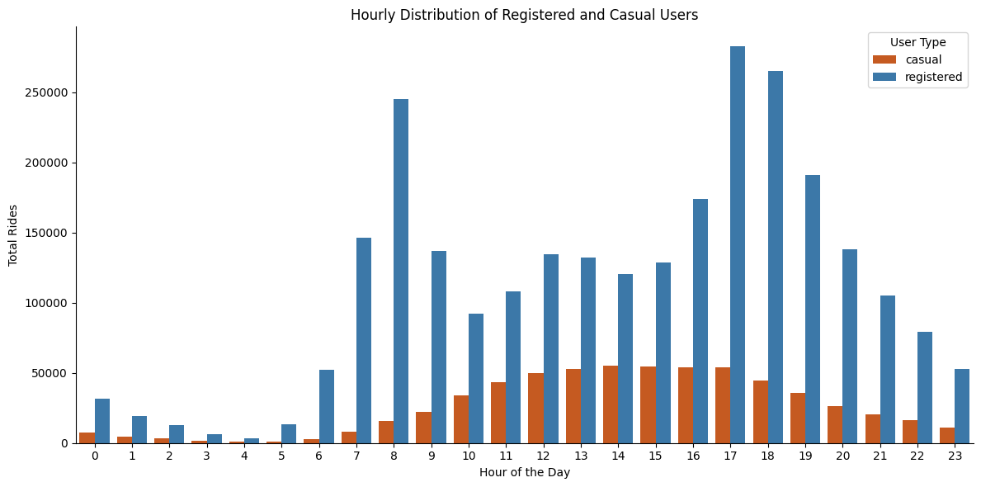
Exploratory data analysis
Data Inspection
Loading the data and checking its shape
Checking for missing values
Getting summary statistics with .describe()
2. Feature Understanding and Transformation
Mapping categorical codes to readable names (e.g., season from numbers to labels like winter, spring)
Understanding the roles of features like hr, weekday, holiday, temp, hum, windspeed, etc.
3. Distribution Analysis
Looking at how numerical variables (like temperature, humidity, count of users) are distributed
Possibly using histograms, boxplots, or density plots

Slide 7
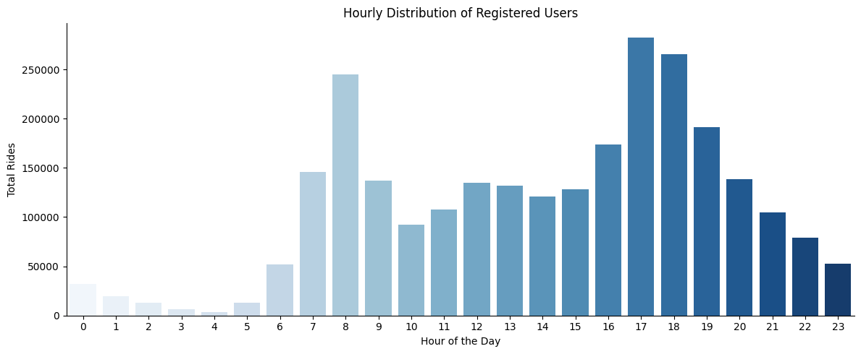
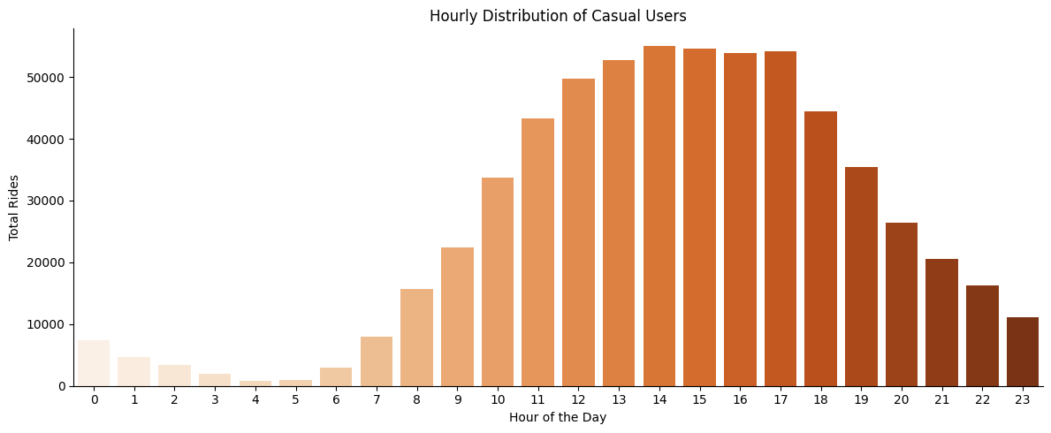
Distribution of users (Registered and casual)

Slide 8
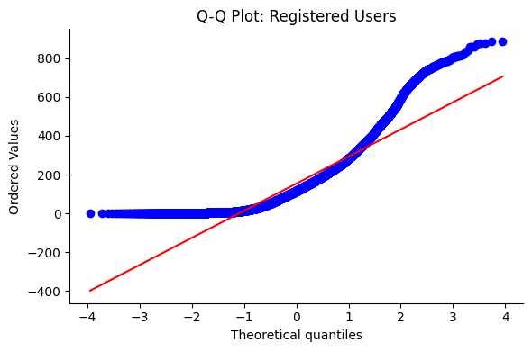
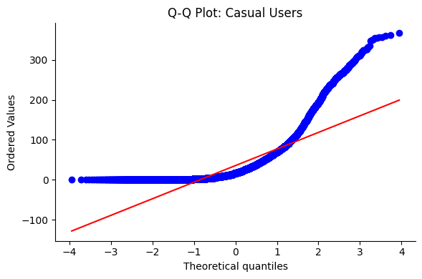
Q-Q plotting
Both registered and casual ride count distributions are significantly non-normal. This is consistent with the nature of bike-sharing data: many hours have low or zero rides, while certain peak hours have much higher activity.

Slide 9
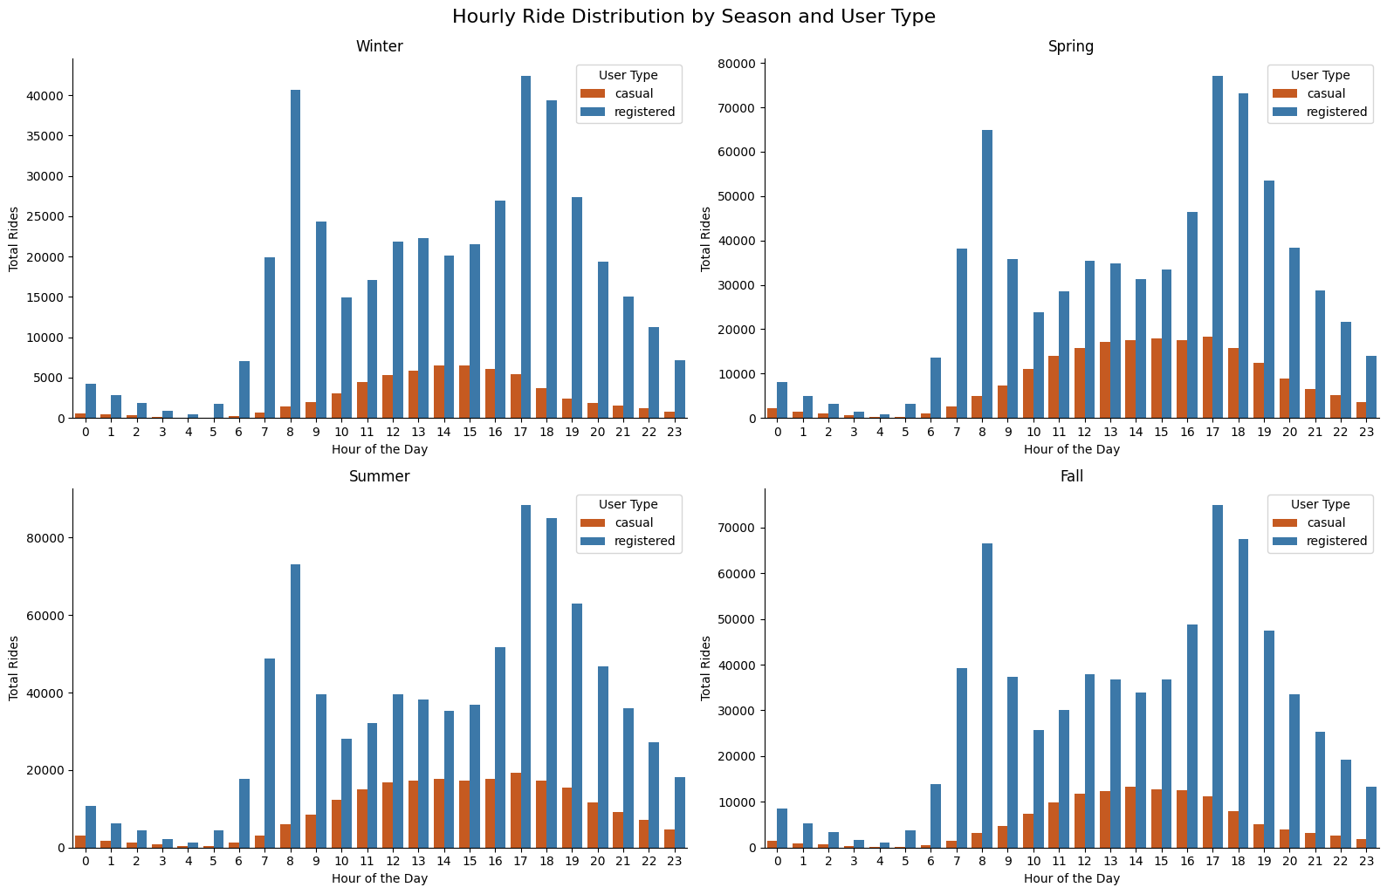
Comparing casual vs. registered user activity Behavior Across seasons
-seasons change doesn’t change the distribution too much

Slide 10
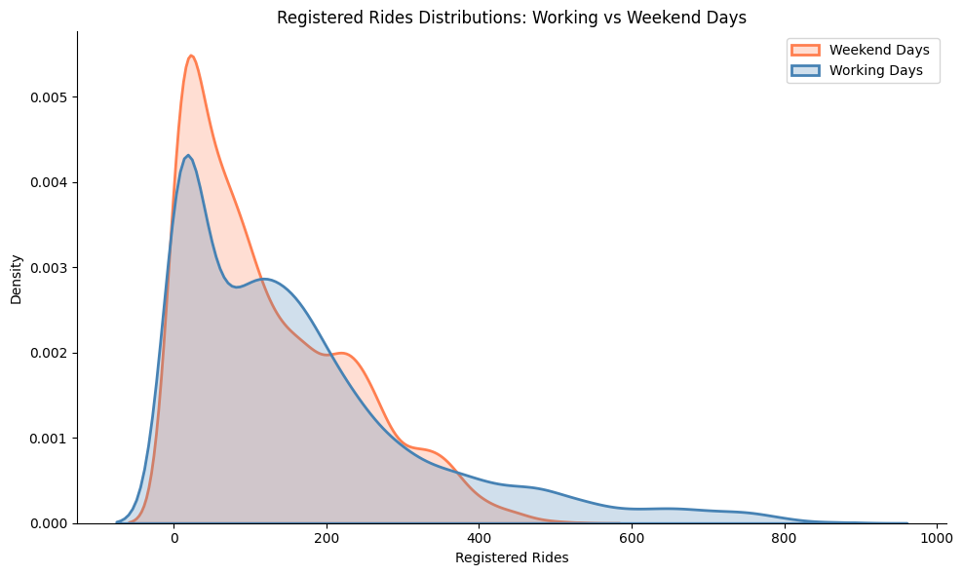
Hypothesis Testing, A/B Testing and Confidence intervals
EX 1. Registered Rides Distributions: Working vs Weekend Days
H₀: average registered rides over weekdays-average registered rides over weekend=0
H₁: average registered rides over weekdays-average registered rides over weekend≠0
We got p-value = 0.00, So we reject the null hypothesis.
The data strongly suggests that user behavior differs between weekdays and weekends likely because registered users are commuters who ride more on workdays.

Slide 11
Hypothesis Testing, A/B Testing and Confidence intervals
EX 1. contd
We Calculate the confidence intervals for both groups and it gives us:
This make sense because registered users are often commuters who use bikes for work or school during the week, while weekend usage drops or follows a different pattern. So, the rejection of the null hypothesis is true.

Slide 12
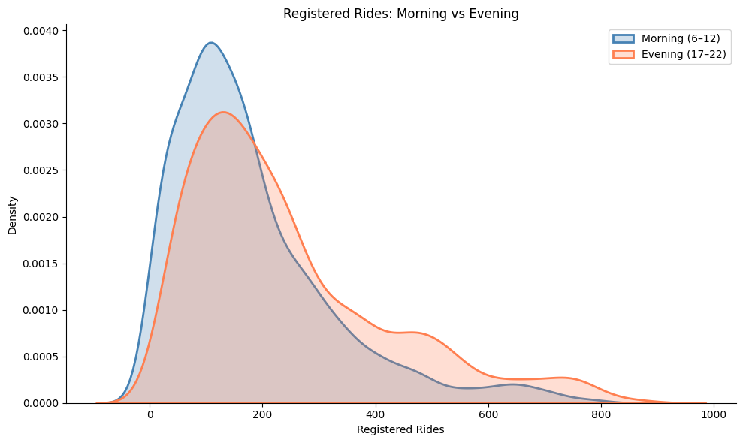
Hypothesis Testing, A/B Testing and Confidence intervals
EX 2. Registered Rides: Morning vs Evening
H₀: Mean registered rides in the morning = evening
H₁: Mean registered rides in the morning ≠ evening
We again got p-value = 0.00, So we reject the null hypothesis.
This suggests that registered riders use the service differently at different times of the day possibly due to commuting patterns (e.g., riding to work in the morning, riding home or for leisure in the evening).

Slide 13
Hypothesis Testing, A/B Testing and Confidence intervals
EX 2. contd
We Calculate the confidence intervals for both groups and it gives us:
This also a strong reason to reject the null hypothesis

Slide 14
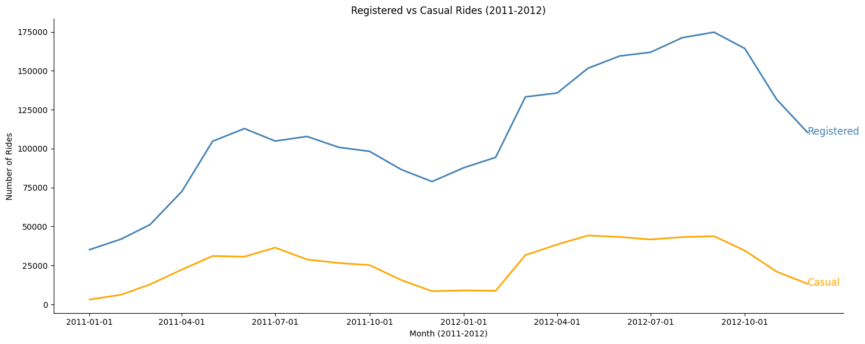
ANOVA Test
Ex 3. Registered Rides by Season
H₀: All seasons have the same mean number of registered rides.
H₁: no season has the same mean.
We got p-value = 0.00, So we reject the null hypothesis.

Slide 15
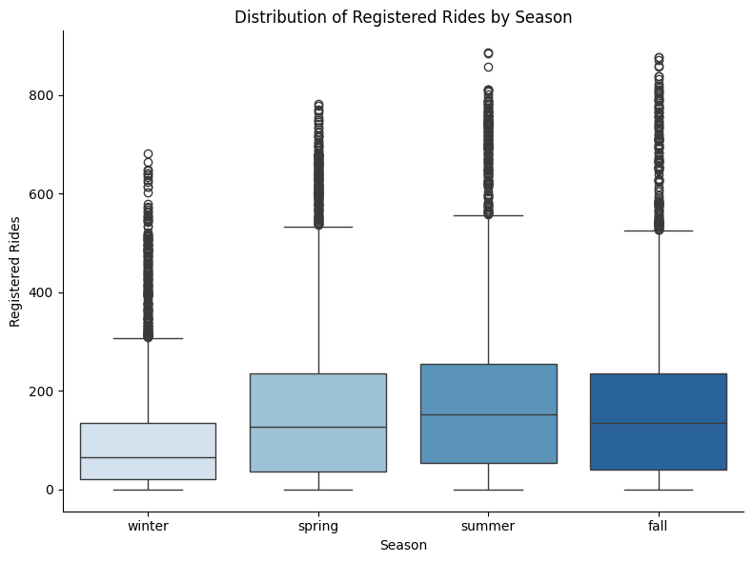
ANOVA Test
Ex 3. contd
By using ANOVA test it tells us that not all seasonal means are equal. The box plot visually confirms this by showing:
Different medians → strong evidence of mean differences
Different spreads → varying variability across seasons
Outliers → possibly interesting cases worth deeper investigation

Slide 16
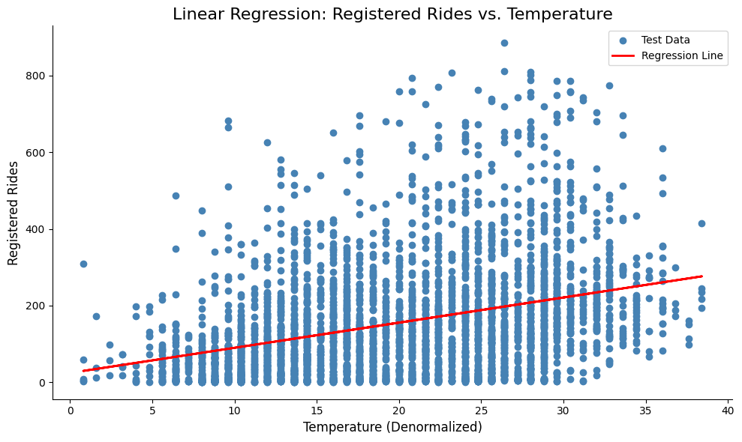

Linear Regression
Ex 4. Does temperature have a linear relationship with the number of registered users?
We predict it doesn’t have relation.
We set the variables:
Y = Registered Rides (Response variable)
X = Temperature (Explanatory variable)
Y = β0 + β1 X
Y= 23.9423 + 6.5658 X
The small value of R^2 says that our prediction wasn’t good

Slide 17
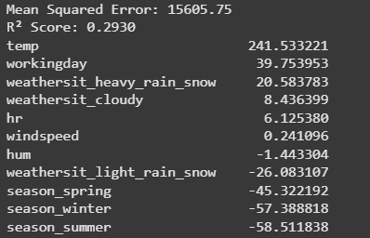
Linear Regression
What happen if use more than one explanatory variable?

Slide 18
Thank You

